Slide 1


Unit-IV- Smart sensors and devices
Types of carbon materials
Morphology
Particle size
Dimensional anisotropy
Carbon quantum dots
Carbon spheres
Carbon fibers
Carbonions
0D - Fullerenes
1D – Carbon nanotubes
2D – Graphene
2D - Graphdiyne

Slide 2
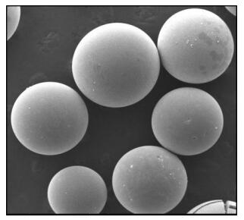
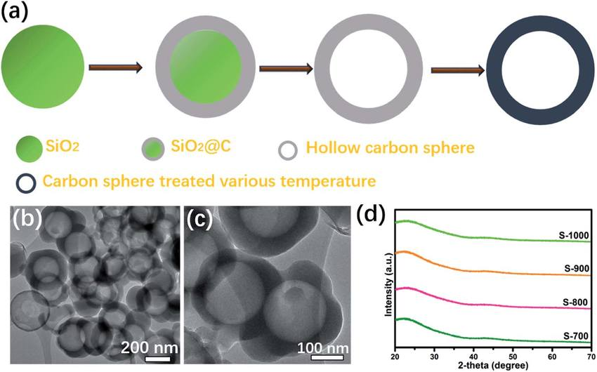
Prepared through template assisted method

Slide 3
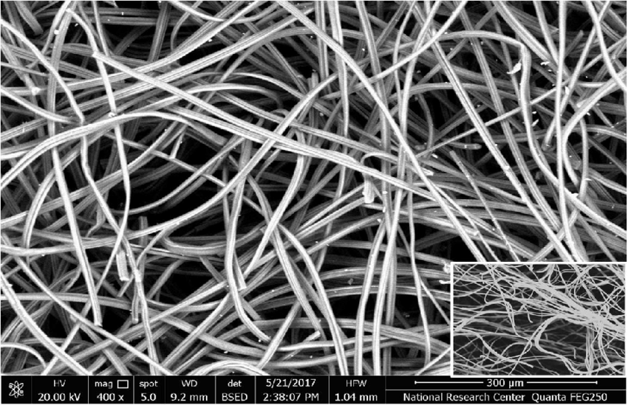

Slide 4
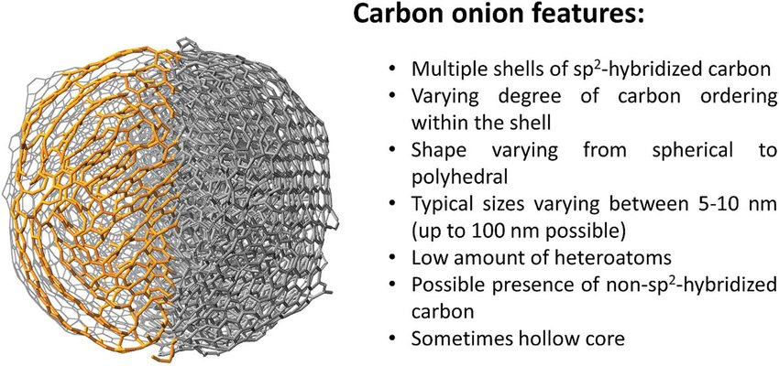

Slide 5
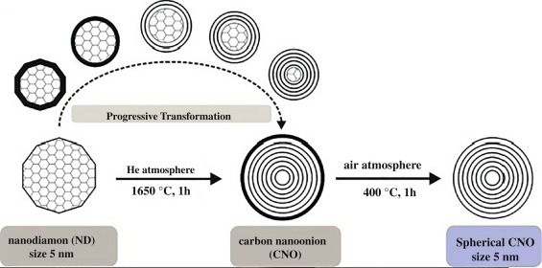
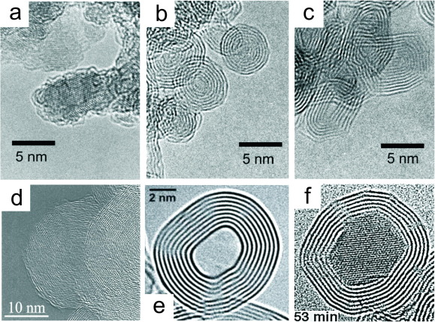

Slide 6
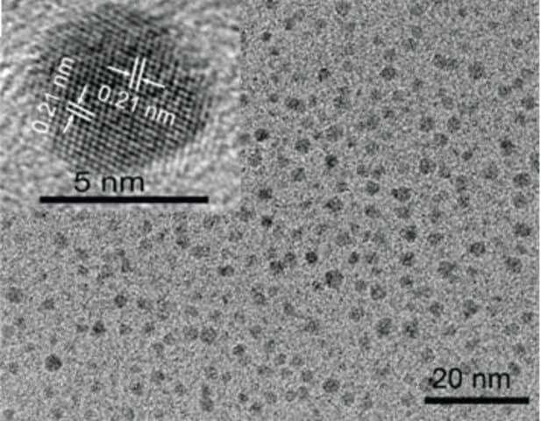
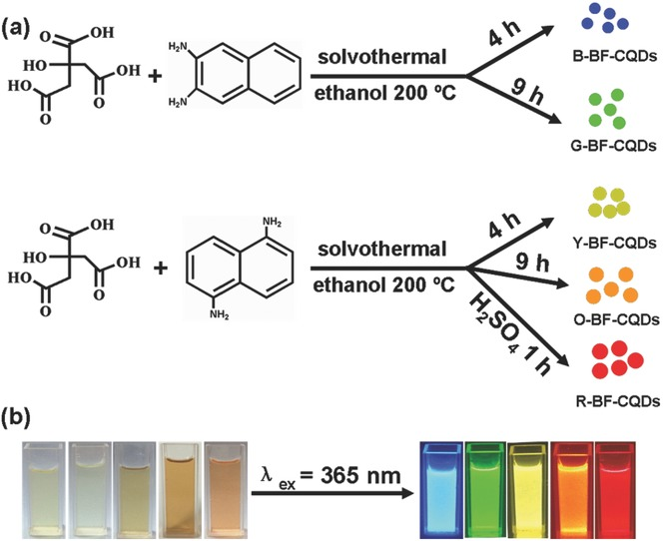

Slide 7
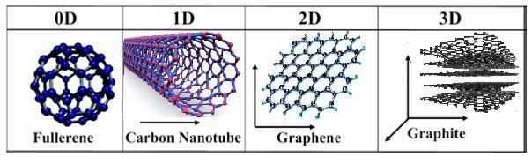

Slide 8
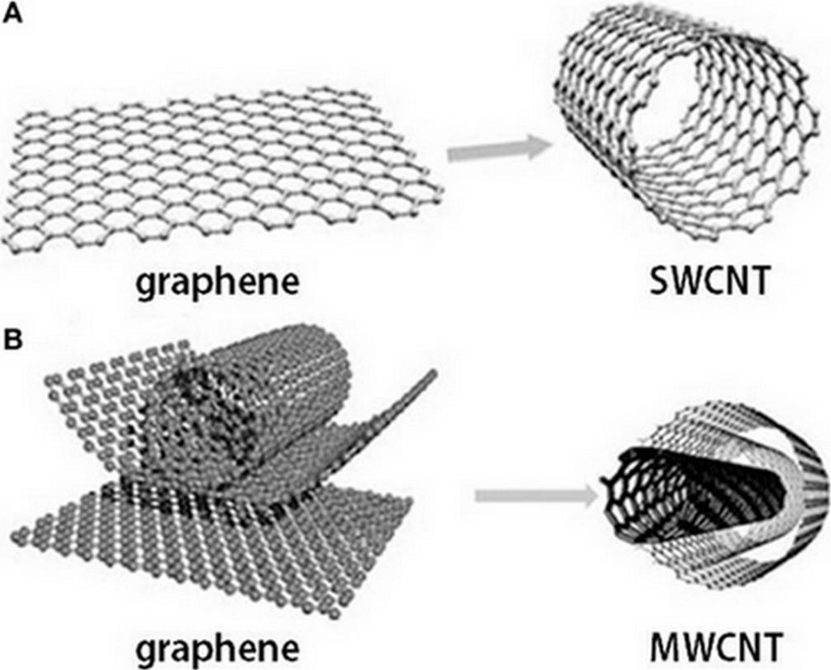
Dimensional anisotropy

Slide 9
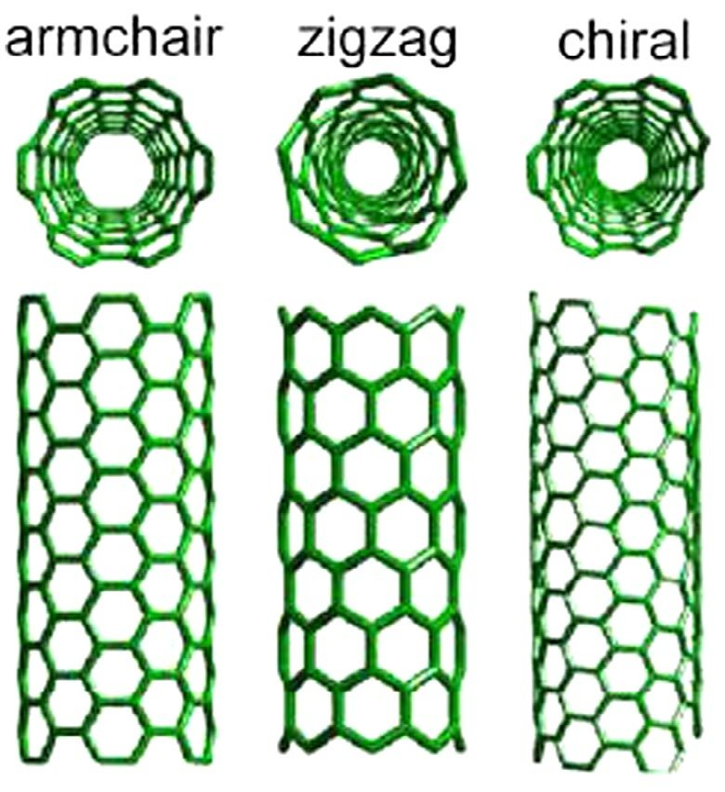

Slide 10
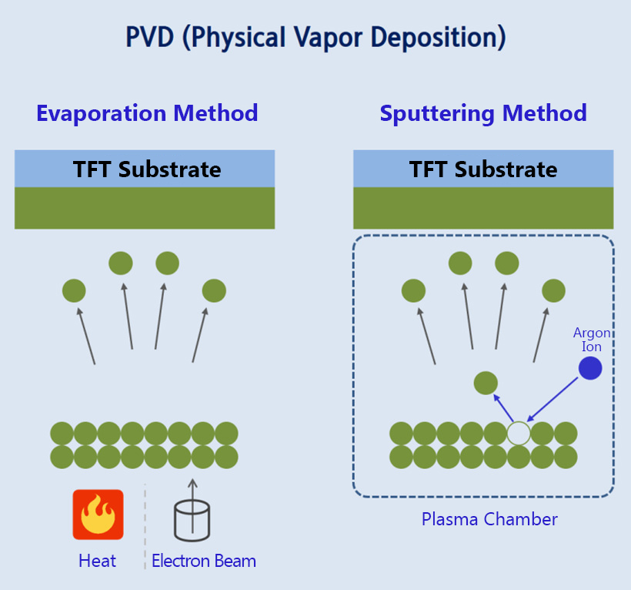
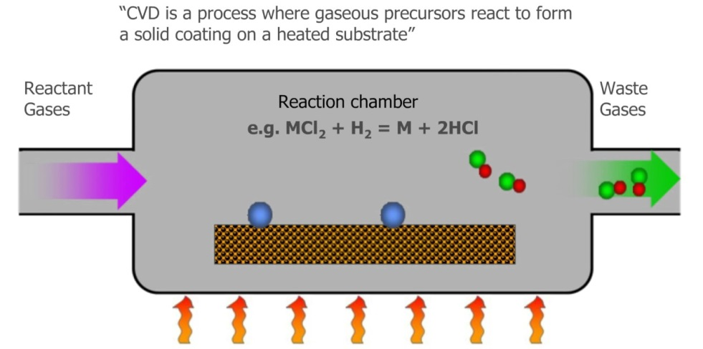
Vapor deposition methods
Physical vapor deposition
Chemical vapor deposition
Atmospheric pressure vapor CVD
Low pressure CVD
Plasma enhanced CVD
Ultra high vacuum CVD
Metal organic CVD

Slide 11
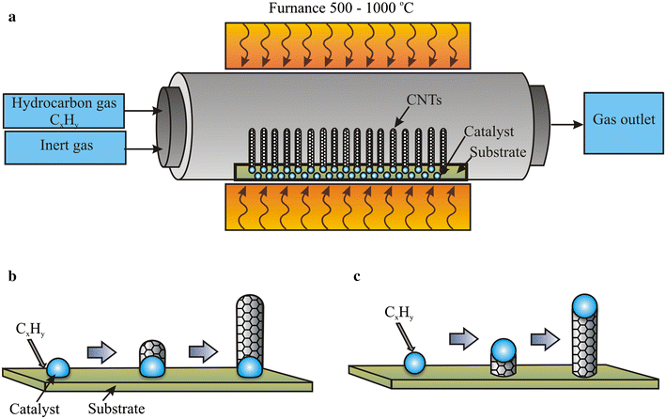
Synthesis of CNTs by modified CVD method:
Chemical Vapor Deposition: Requirements:
High Temperature Tubular furnace (500 to 1500 ℃)
Source of Carbon: Methane, ethylene, hydrocarbon gas, xylene, natural gas
Substrate: carbon, quartz, silicon
Inert gas: Argon, Hydrogen, Nitrogen
Catalyst: Ferrocene, Nickellocene, Cobaltocene
Zaytseva, O., Neumann, G. Carbon nanomaterials: production, impact on plant development, agricultural and environmental applications. Chem. Biol. Technol. Agric. 3, 17 (2016). https://doi.org/10.1186/s40538-016-0070-8

Slide 12
Steps: Procedure involves as follows
The cleaned quartz/carbon/silica substrate is placed in the middle of the tubular furnace.
In order to maintain the inert atmosphere inside the furnace, initially the air/oxygen present inside the tubular furnace has to be removed by passing the argon or nitrogen gas for about 30 min.
After maintain the inert gas atmosphere, the required temperature is set with slow heating rate.
The hydrocarbon precursors in gaseous forms along with ferrocene and Benzene/toluene vapors are pumped into the reaction chamber.
The furnace is heated up to 850–1000 °C and 550–700 °C for SWCNT and MWCNT production respectively.
Initially, at high temperature, due the thermal decomposition of hydrocarbon, carbon atoms are formed are dissolved in the metal nanoparticle catalyst.
Once the threshold concentration of carbon in the catalyst reached, a semi fullerene cap type of structure is formed due to precipitation of carbon atoms. This acts as a seed for further crystal growth, which further continues to grow in tubular form results in to CNT.
After the formation of CNT on catalyst is completed as shown in the above figure, the supply of the reactant/catalyst varpors are stopped.
Then the furnace temperature is reduced slowly to room temperature and supply of the inert gas also stopped.
The CNT formed on catalyst is taken out along with the substrate, subjected to purification.
Zaytseva, O., Neumann, G. Carbon nanomaterials: production, impact on plant development, agricultural and environmental applications. Chem. Biol. Technol. Agric. 3, 17 (2016). https://doi.org/10.1186/s40538-016-0070-8

Slide 13
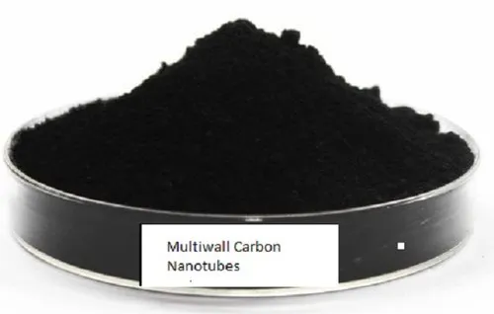
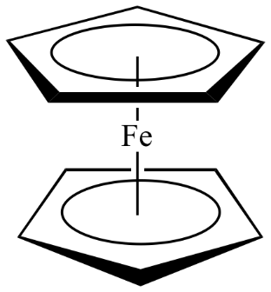

Slide 14
Substrate is coated with metal seeds
Substrate is a glass or wafer surface and are exposed to various gaseous reactants/products
Gaseous precursors and carrier gases are transported into the deposition region
Adsorption of the reactant over the substrate surface
Surface reactions – Chemical decompositions and adsorptions
Desorption of byproducts away from the deposition region.
Interactions between the gaseous precursors and reactants with substrate determines
the deposition rate
Metal seeds = Ni, Co, Fe

Slide 15
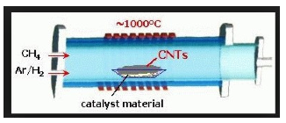
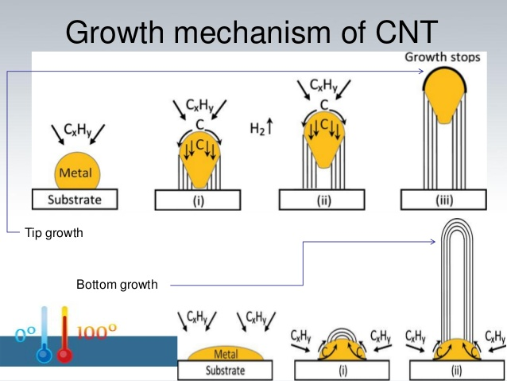
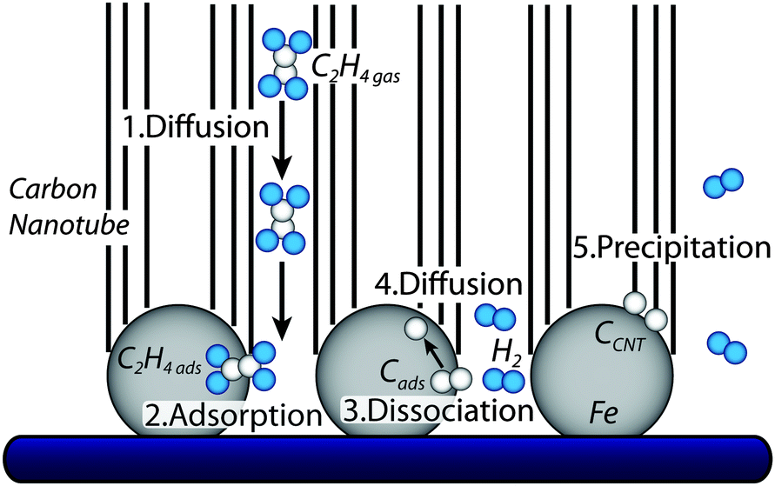
CNT growth mechanism in CVD

Slide 16
Functionalization of carbon nanotubes
Hydrophobic and tend to agglomerate due to the Vander Waals forces –
poor dispersion in liquid phase
Functionalization
Hydrophilic and high degree of dispersion in various solvents

Slide 17
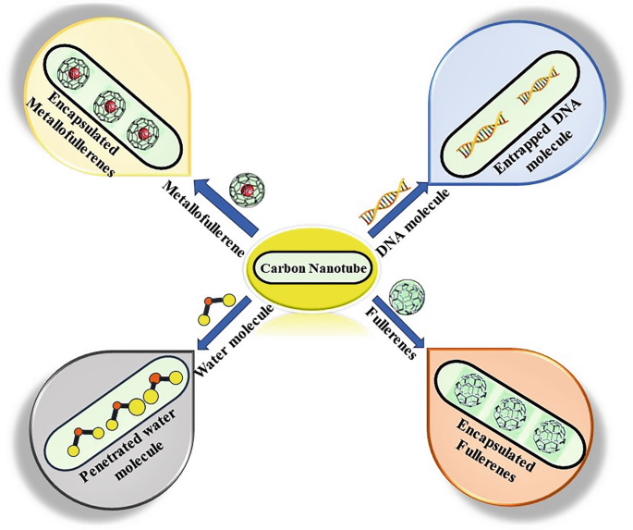
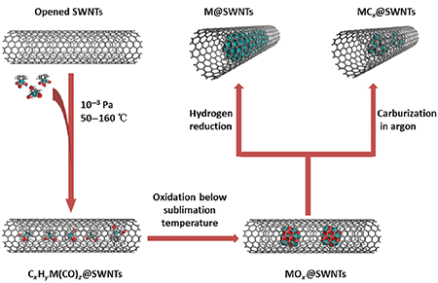
Endohedral Functionalization

Slide 18
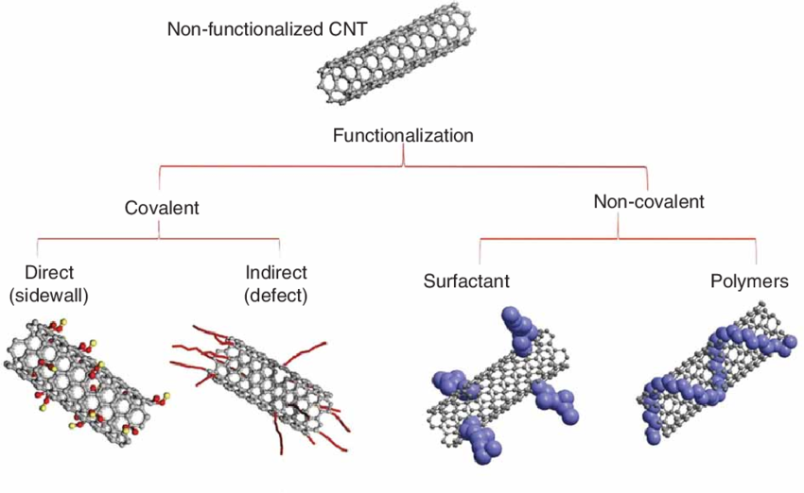
Exohedral Functionalization

Slide 19
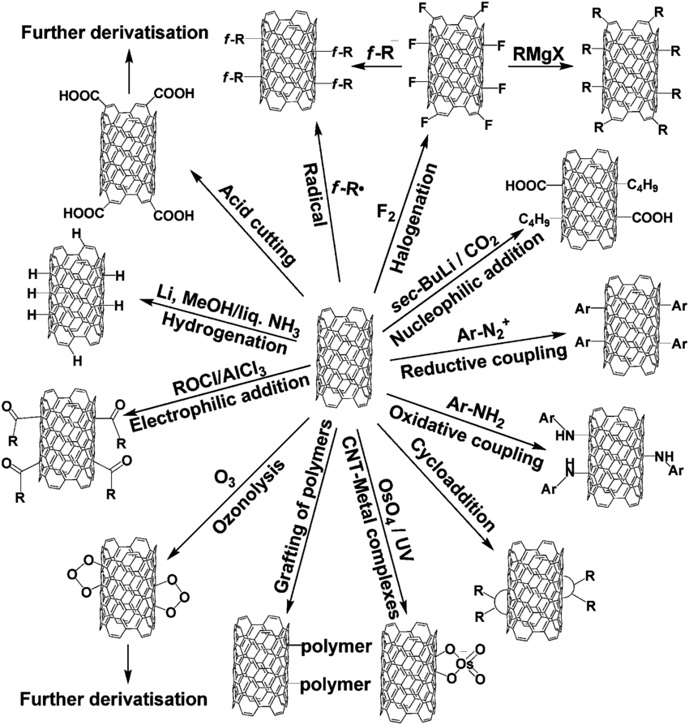

Slide 20
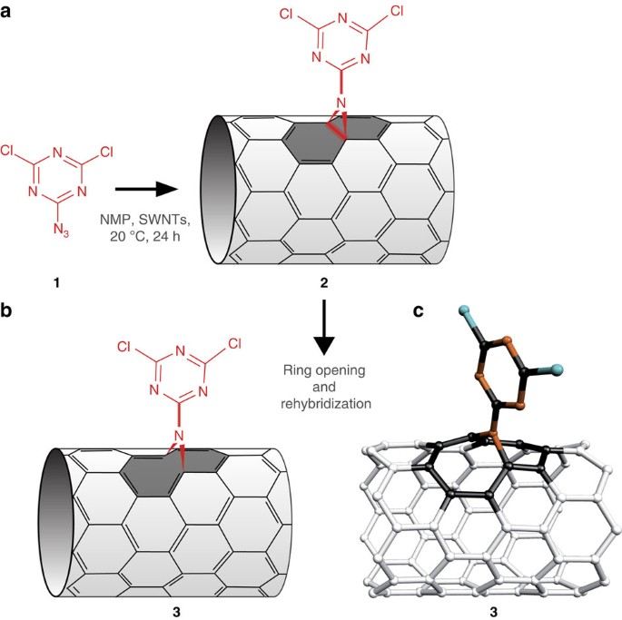

Slide 21
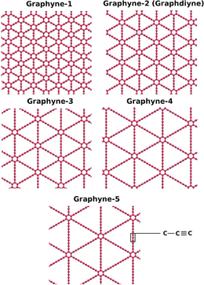
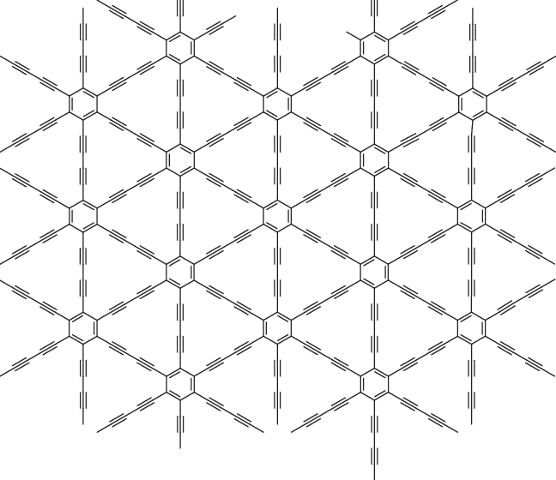

Slide 22
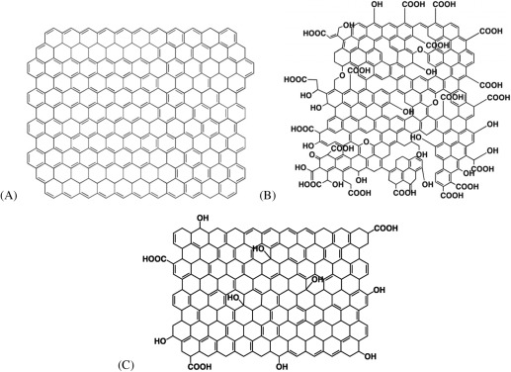

Slide 23
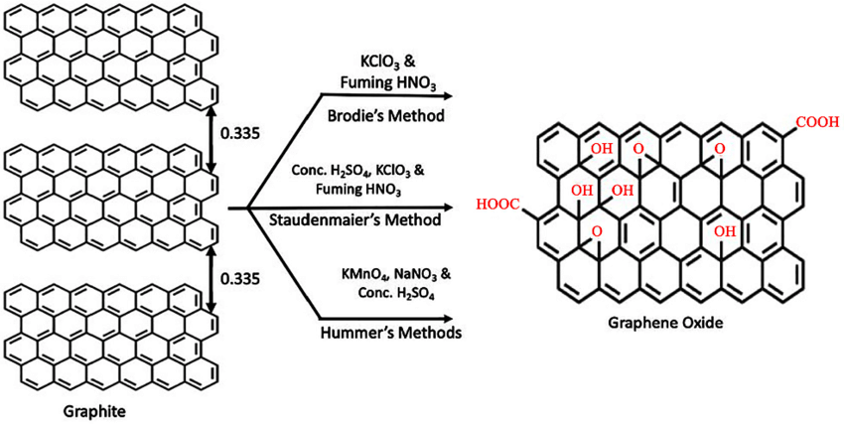

Slide 24
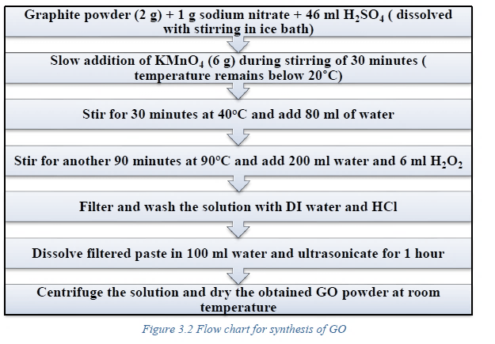
Stage-I: Synthesis of GO (graphene oxide) from graphite powder

Slide 25
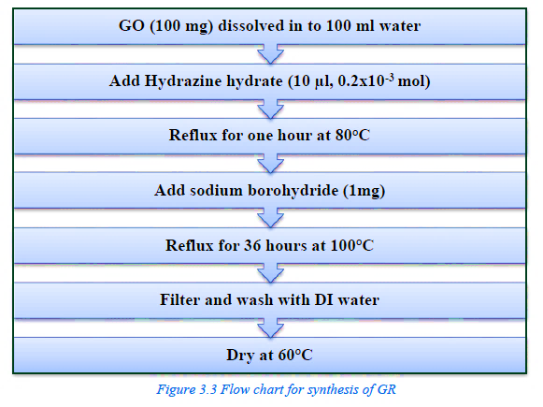
Stage-II: Synthesis of Graphene from GO (graphene oxide)

Slide 26
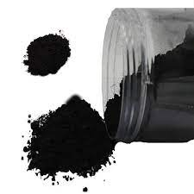
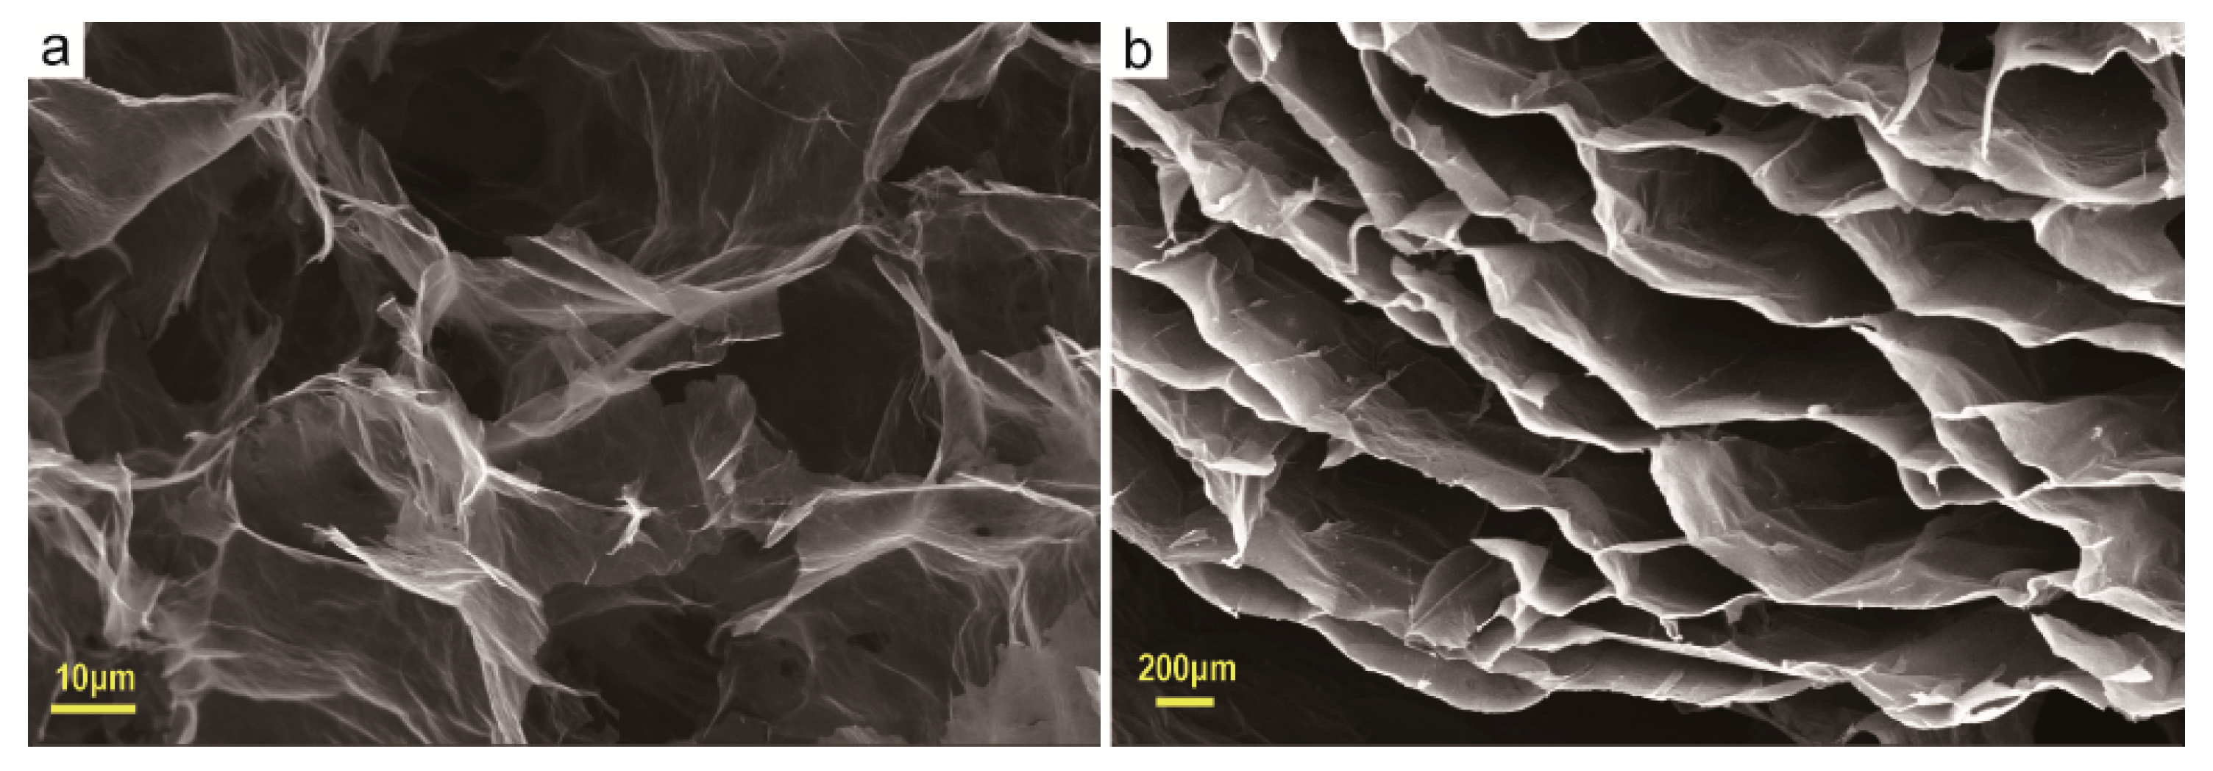
SEM images of Graphene
https://doi.org/10.3390/ma13153271

Slide 27
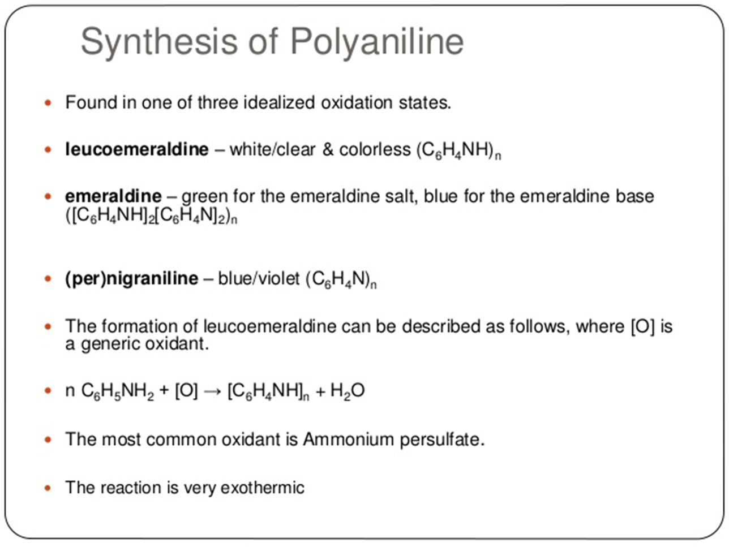
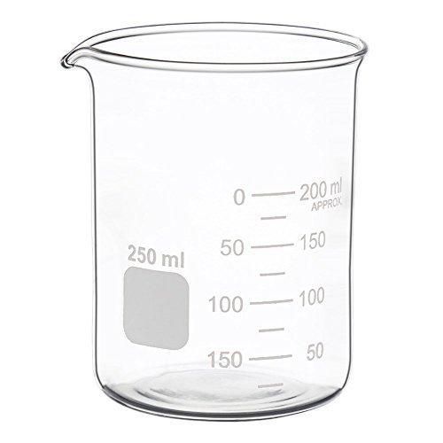
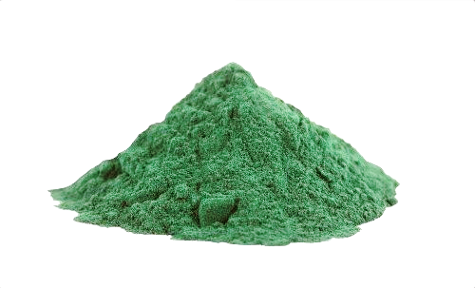
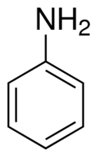
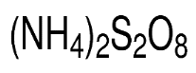
250 ml
beaker
APS (oxidant) solution is
added to aniline
solution with
vigorous stirring
at ~0 ℃.
APS (5g) dissolved in
50 ml of 1.0M HCl
Aniline (2ml) dissolved in
50ml of 1.0M HCl
Polyaniline
powder
After the polymerization reaction, the resultant mixture is filtered and washed successively using 1.0M HCl followed by double distilled water, several times until the washings become colorless.
Finally the residue was washed with acetone and dried at 60 ℃.

Slide 28
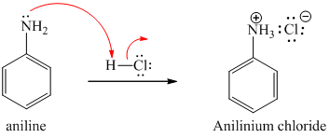
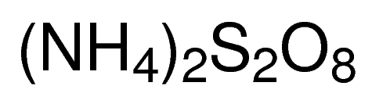
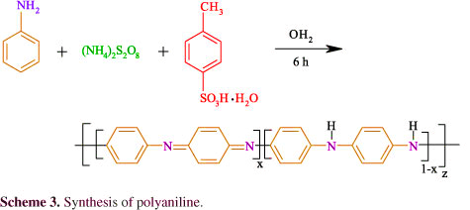
Polyaniline polymerization reaction
HCl - Catalyst
Polyaniline is synthesized by oxidative polymerization of aniline
Stirring
at ~0 ℃
Oxidant
Quininoid
Benzenoid

Slide 29
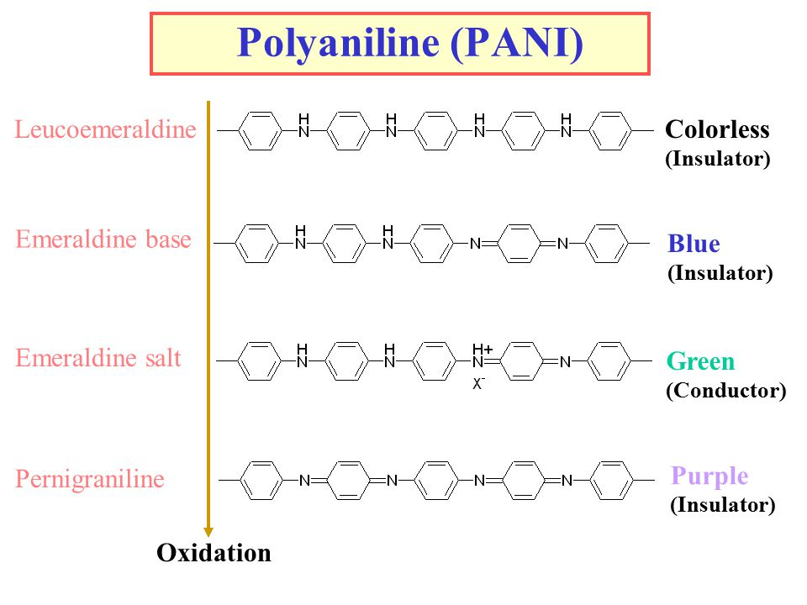
Different forms of POLYANILINE
x=0
x=0.5
x=0.5
x=1

Slide 30
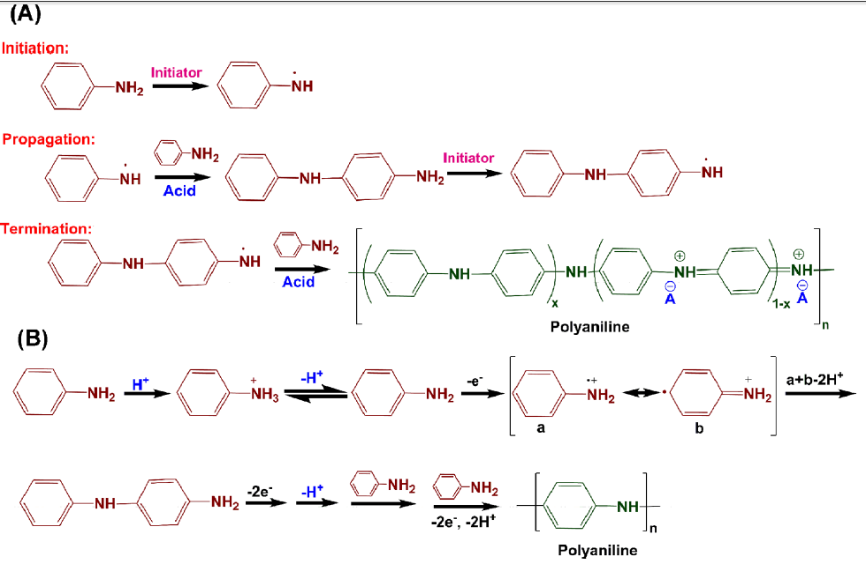


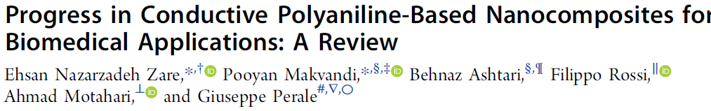
Chemical polymerization mechanisms of polyaniline.
2019, https://doi.org/10.1021/acs.jmedchem.9b00803

Slide 31
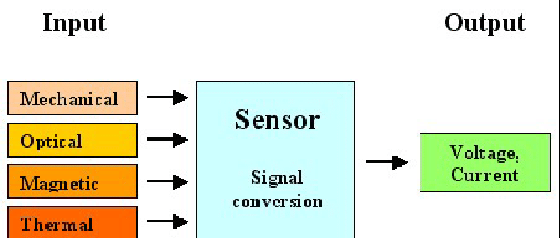
Sensor
It is device that measures change in a physical (heat, light, sound, pressure etc) and/or chemical (pH, smell, taste, concentration, humidity etc) parameters of interest in an environment and transforms it into an electronic signal

Slide 32
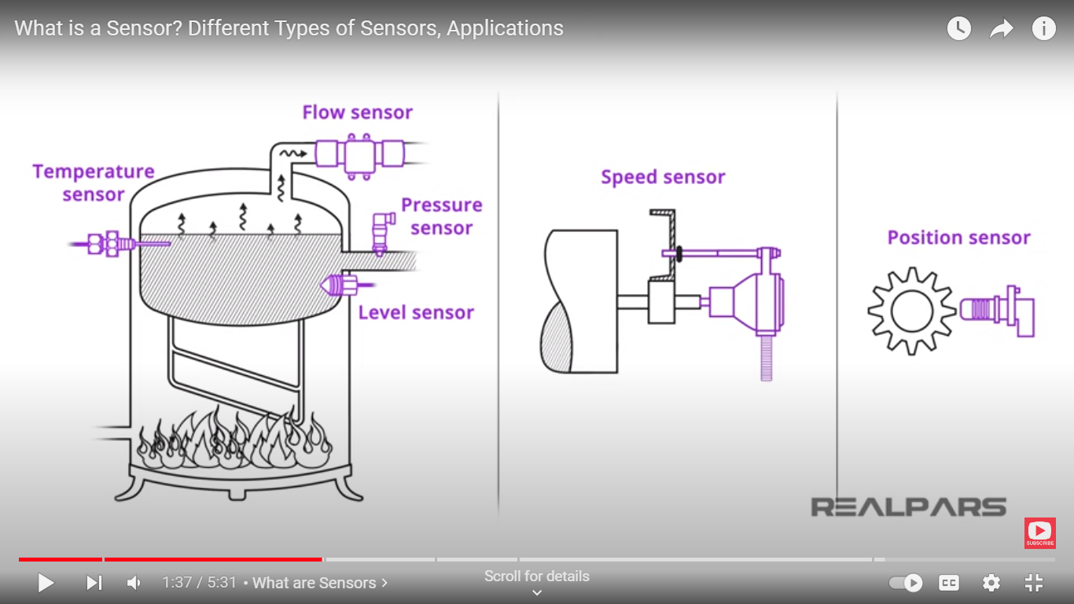

Slide 33
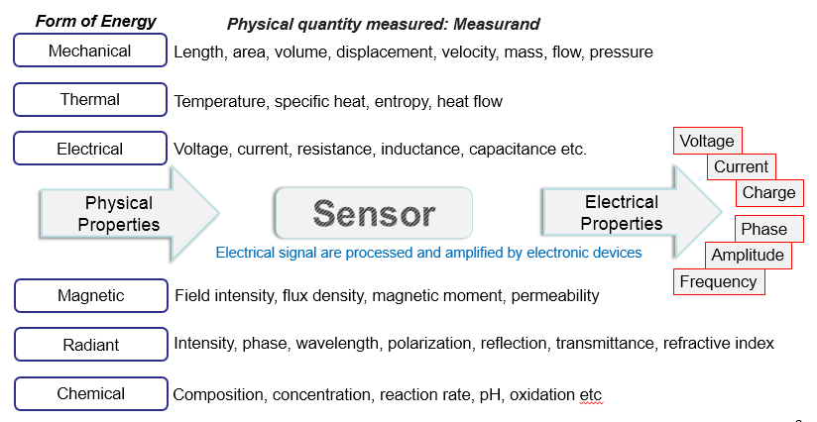

Slide 34
SENSORS
Based on power source:
Active sensors: Requires external power signal: thermocouple
Passive sensors: do not require any external power signal and directly generates output:
Thermistors
Means of detection: Biological, chemical, radioactive sensors
Based on conversion phenomenon: electromagnetic, Electrochemical, thermoelectric
Based on Output:
Analog sensors: temperature sensors –continuous output signal
Digital sensors: discrete signals: IR sensors

Slide 35
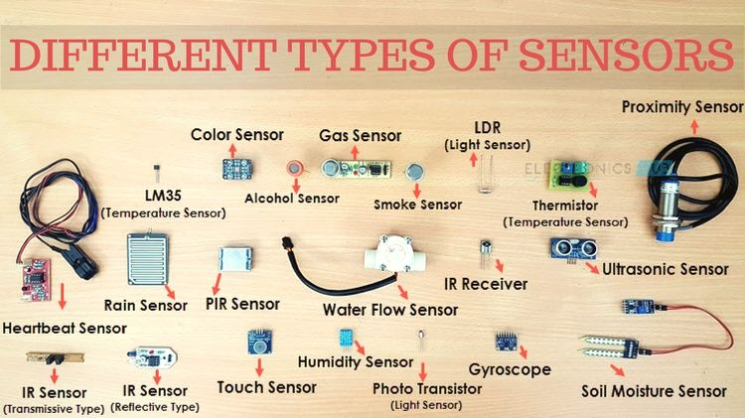

Slide 36
Electrochemical (EC) Sensors:
a device that converts chemical composition data of the analyte into an analytically usable signal.
In electrochemical sensor, the electrode system consist of three electrodes such as working electrode (WE), counterelectrode (CE) and reference electrode (RE).
It has a potentiostat, which is an electronic instrument that controls the voltage between two electrodes.
Working electrode (WE) is very sensitive to any change in analyte solution, provides the surface for the analyte to undergo reaction, when the potential is applied between WE and RE.
The CE helps in completing the circuit by allowing the reaction, which is opposite to WE reaction, to happen. If an oxidation reaction happens at WE, reduction reaction will take place at CE, and vice versa.
The RE is independent of the analyte and other ions concentration. Its potential is constant while measuring the potential of WE. By measuring the current of redox reaction, the analyte can be identified.

Slide 37
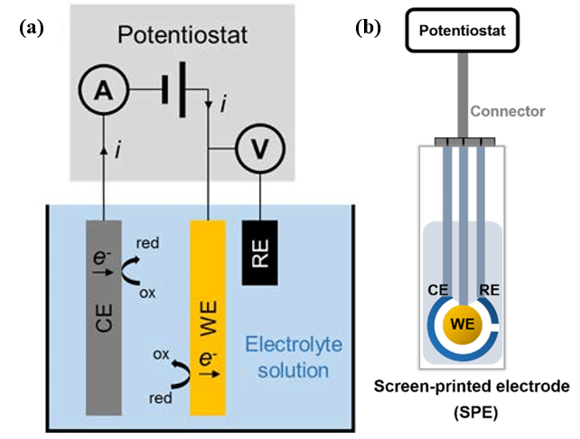
Three electrode systems used in electrochemical sensor

Slide 38
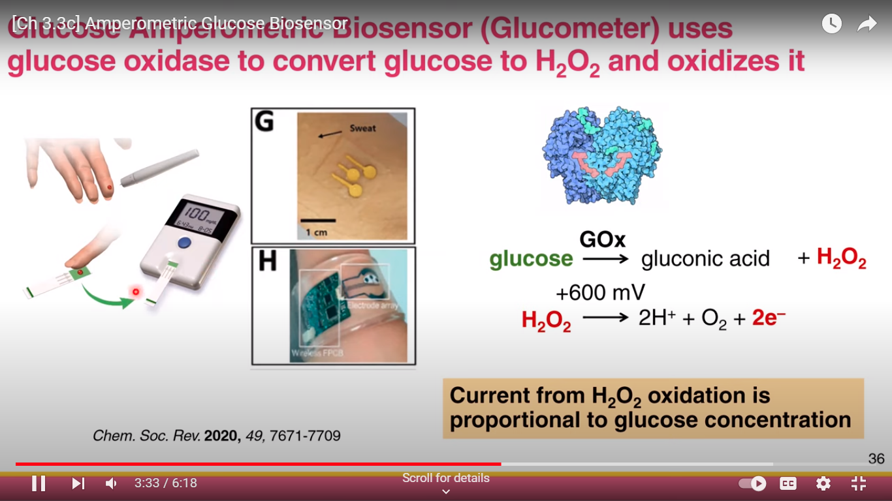
Applications of Electrochemical sensor
Detection of glucose:
Bio sensors: glucose oxidase is derived from biological species
Amperometric sensors: measuring the anodic current

Slide 39
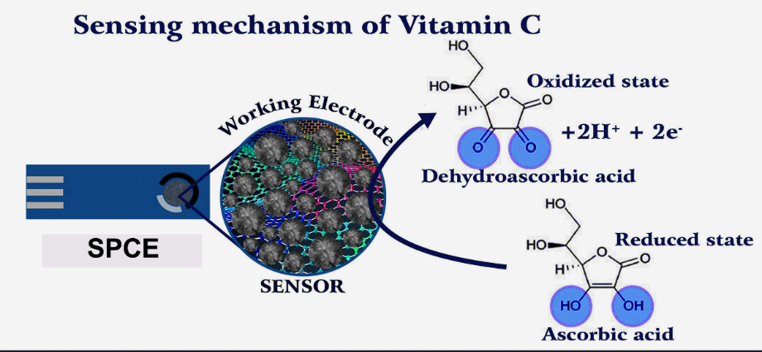
Ascorbic acid sensor
Ascorbic acid (AA) is also called as Vitamin C, an essential nutrient and antioxidant required for the human body. Unfortunately, the human body cannot produce/synthesize this biomolecule, and hence it should be consumed by food and drugs. The deficiency of AA lead to scurvy, mental disorder, cancer, etc. Similar to glucose, the AA can also be analyzed in EC sensor and the following schematic representation depicts the sensor mechanism of AA.

Slide 40

GAS SENSORS

Slide 41


Slide 42


Slide 43


Slide 44

SEVEN CRYSTAL SYSTEMS

Slide 45

Piezoelectric effect
Any material under mechanical stress generates electric current – piezoelectric material

Slide 46
Piezoelectric sensors – Vibration sensors
Converting sound waves to electric signal
Mechanical oscillation about an equilibrium position or
To and fro motion of an component
without any displacement
Strain gauge – measures the strain on a machine component –
resistance varies with applied force (pressure, weight, tension) into change in
electrical resistance
For instance, external force applied to a stationary object, stress and strain results-
Change in the length of wires – resistance varies
Parameters: Range, accuracy, environmental conditions, shape of the measuring surface

Slide 47



Slide 48

Scanning the barcode

Slide 49

RFID: Radio frequency identification technology

Slide 50

RFID – To track the objects using radiowaves (300 GHz to low as 3 kHz)
RFID tag transmits feedback signal to the reader within the limited distance
RFID reader can track multiple objects at the same time

Slide 51

Passive tag: no power supply, absorb the energy from the reader itself
Semi passive tag: has own power supply, but still rely on reader for transmitting the signal
Active tag: power supply, and to transmit the signal also they rely on their own power supply

Slide 52


Slide 53


Slide 54


Slide 55








Materials for RFID tag
Polyethylene Terephthalate (PET)
as substrate

Slide 56


Slide 57


Slide 58
Discuss the preparation of PANI and write its different forms.
Discuss the preparation of graphene oxide from Hummer’s method
and mention any four applications.
Discuss the preparation of CNTs from CVD and mention their four applications.
Discuss any four methods of functionalization of CNT/graphene
Discuss the RIFT working principle
Discuss the importance of IOT and IONT with examples.
Discuss the device construction and working principle of DSSCs/bulk
Heterojunction solar cells; Si solar cells.
Discuss the working principle of EDL capacitors
Discuss the working principle of pseudo capacitors
Discuss the difference between Faradiac and non-Faradiac charge transfer process
Discuss the criteria for electrode materials and electrolytes to be used for super capacitors.

Slide 59

Internet of things

Slide 60



Slide 61


Slide 62


Slide 63



